Slide 1
Crab Game
By Ethan Smith

Slide 2
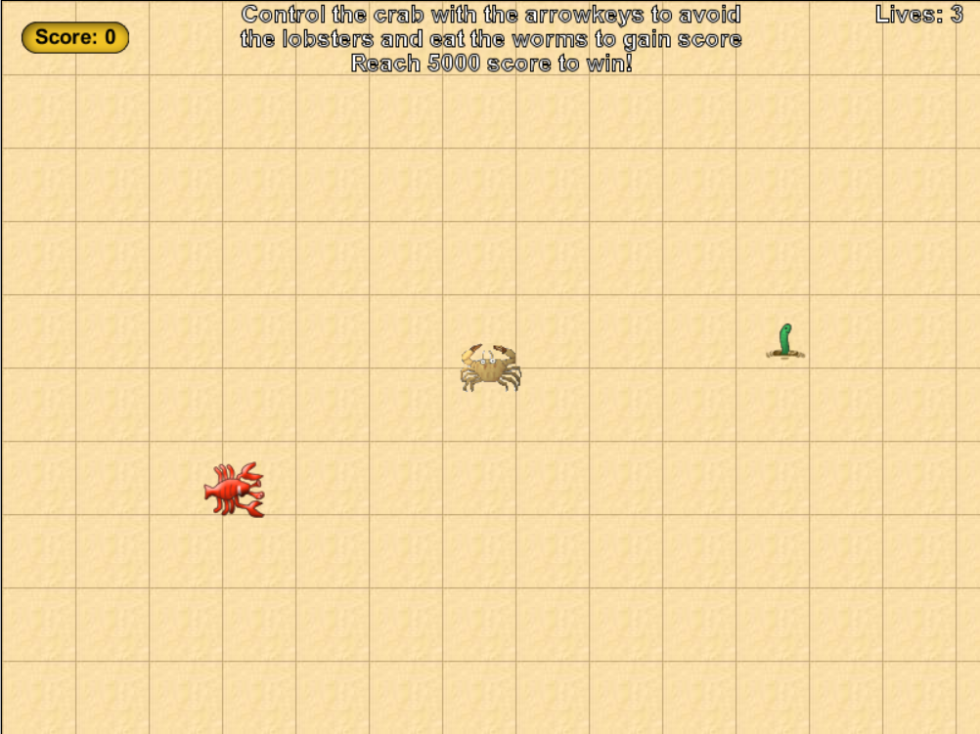
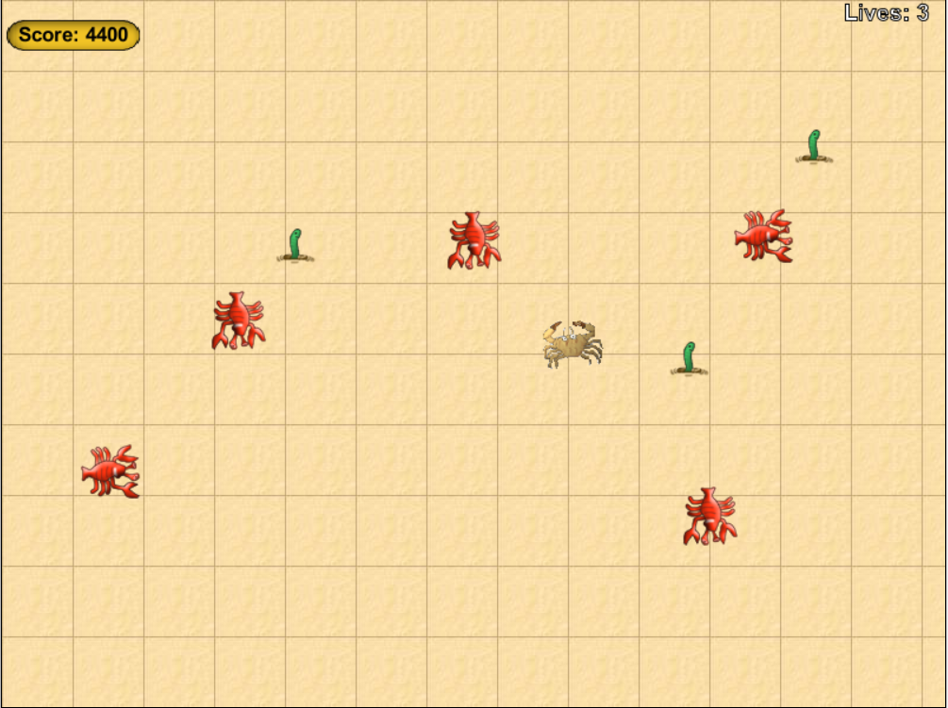
Introduction
In crab game, the crab has to eat all the worms while avoiding the lobsters.
The player will gain 100 points for every worm they eat, needing to reach 5000 to win.
The player will also have 3 lives, losing 1 each time they collide with a lobster, losing all 3 loses the game.
The more points the player has, the more worms and lobsters spawn
The world at the beginning of the game
The world near the end of the game

Slide 3
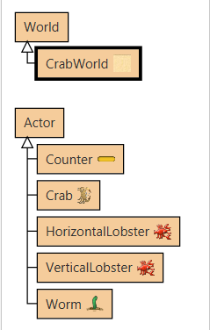
Design Considerations
I created 6 classes for this game: CrabWorld, Counter, Crab, Worm, HorizontalLobster and VerticalLobster
The player controls the crab, the worms randomly spawn in the world and are eaten by the crab and the Counter tells the player the score
The two Lobster classes are used in different orientations, as they are checking for different coordinate types (one is checking X coordinates, the other is checking Y coordinates) to make sure they keep wrapping around the world

Slide 4
Development
Development started out very difficult to my lack of knowledge with greenfoot
After a while of adding more basic features such as the crabs movement is started to find it easier as I found it easier to understand how greenfoot works
By completion, I now have a much better understanding of how greenfoot works, and how to call methods from the world

Slide 5
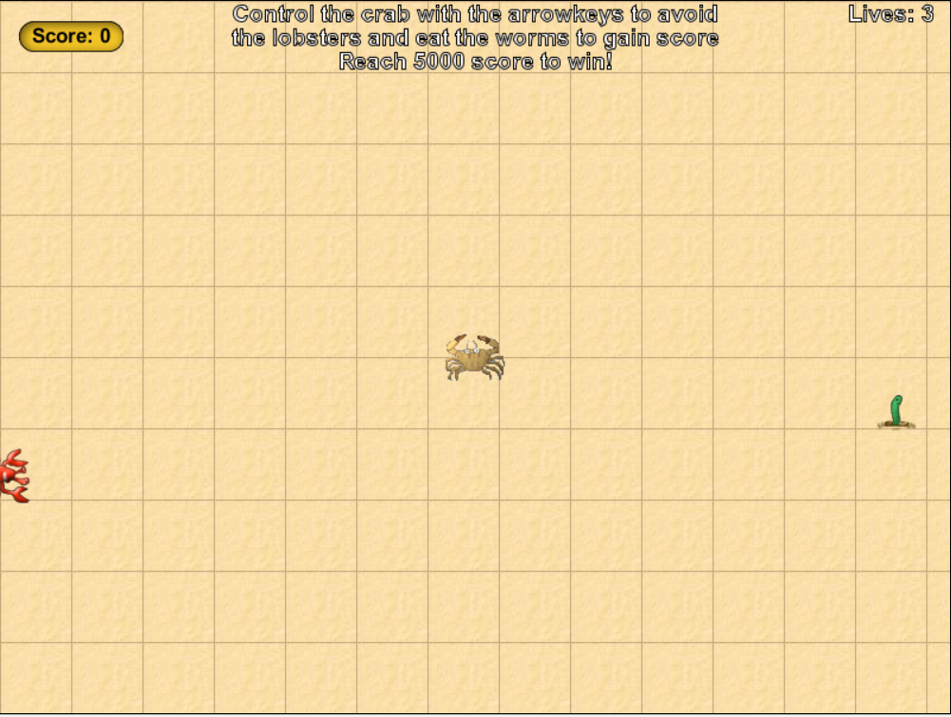
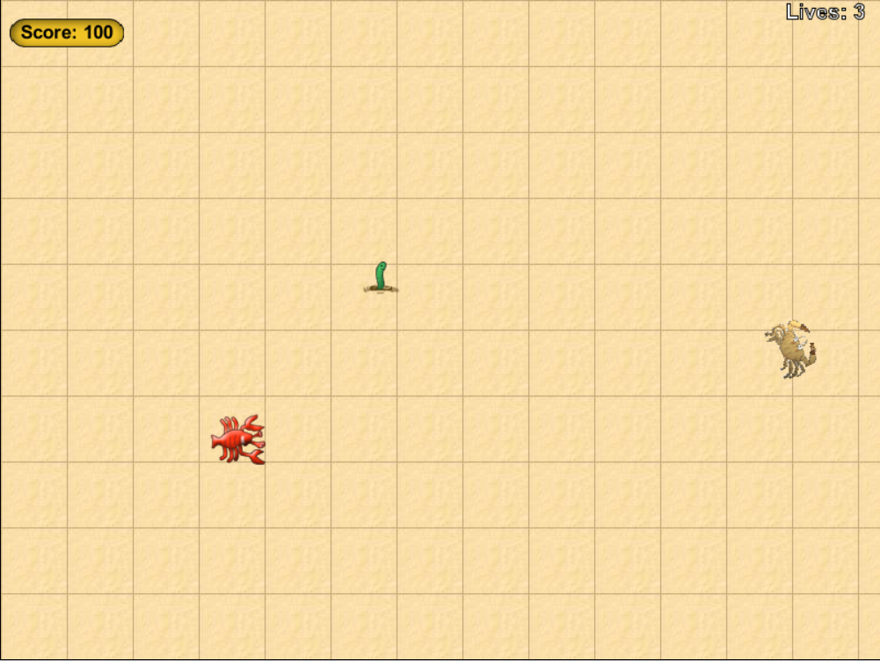
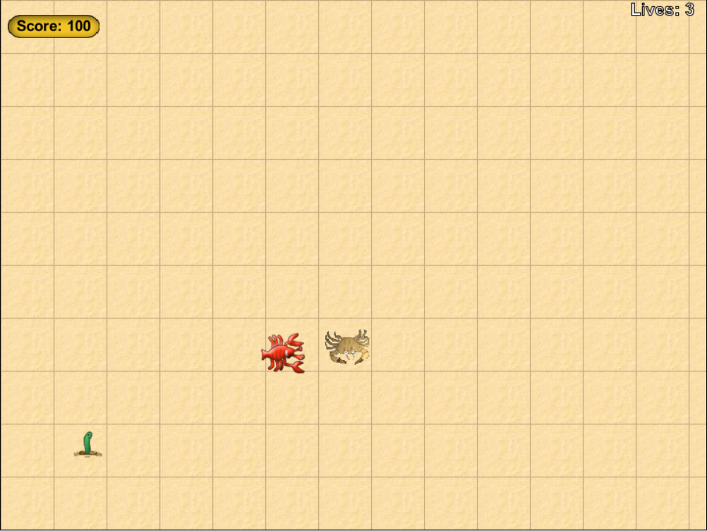
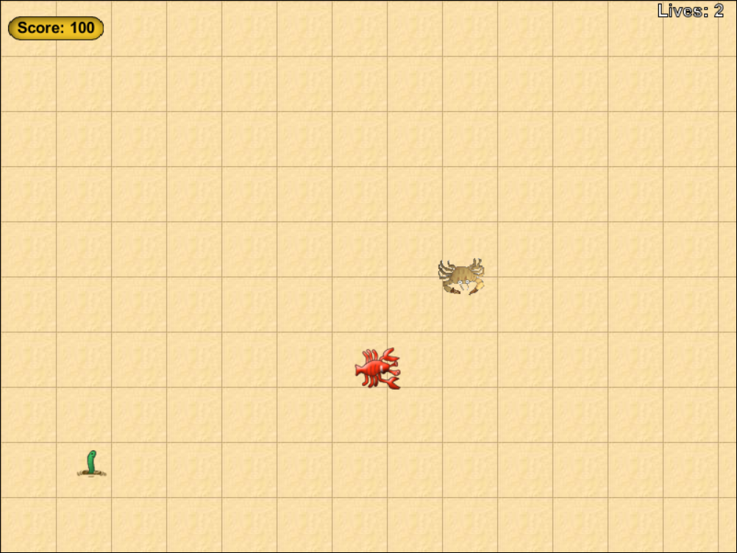
Testing
The world at the beginning of the game
The world after eating a worm showing the point increase and removal of explanation text
The world before being hit by a lobster
The world being hit by a lobster, showing the loss of a life and the crab being moves to a safe spot

Slide 6
Evaluation
The main thing I learned is the use of object oriented programming, helping to break up different sections of code so its easier to identify what code does what
I would like to add more mechanics to the game, however I didn’t get time to try adding many and also did not have time to get a couple I tried working, so they had to be removed

